Slide 1
Exploring Machine Learning (ML) Business Use Cases

Slide 2
Introduction
Machine Learning (ML) provides businesses with data-driven insights to solve real-world problems.
Understanding different business workflows is crucial for developing effective ML solutions.
ML is applied in various industries like finance, healthcare, retail, and manufacturing to enhance efficiency.
The ultimate goal of ML is to optimize decision-making, improve operations, and reduce costs.
This chapter highlights practical use cases of ML across industries, demonstrating its potential impact.

Slide 3
Key Industry ML Use Cases
ML is applied across various industries to solve critical business challenges. Industries covered include:
Financial services
Healthcare
Retail
Manufacturing
Automotive

Slide 4
ML in Financial Services
Financial services use ML to improve decision-making in areas like trading, risk management, and customer service.
ML models detect fraud and streamline processes in banking, insurance, and investment sectors.
Automation in loan approvals through ML reduces human errors and increases processing speed.
Banks enhance customer experience using ML-powered personalization for tailored financial advice.
ML helps financial institutions optimize resources, cut operational costs, and stay competitive.

Slide 5
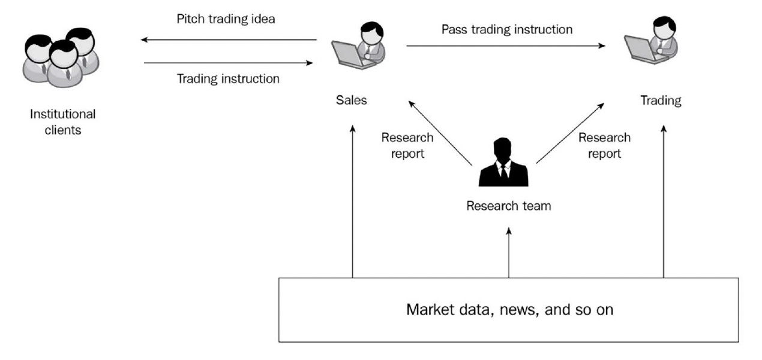
Capital Markets
ML helps optimize trading strategies and generate market insights.
Applications include sales, trading, and research.
ML models analyze large amounts of data to inform trading decisions and reduce trading costs.

Slide 6
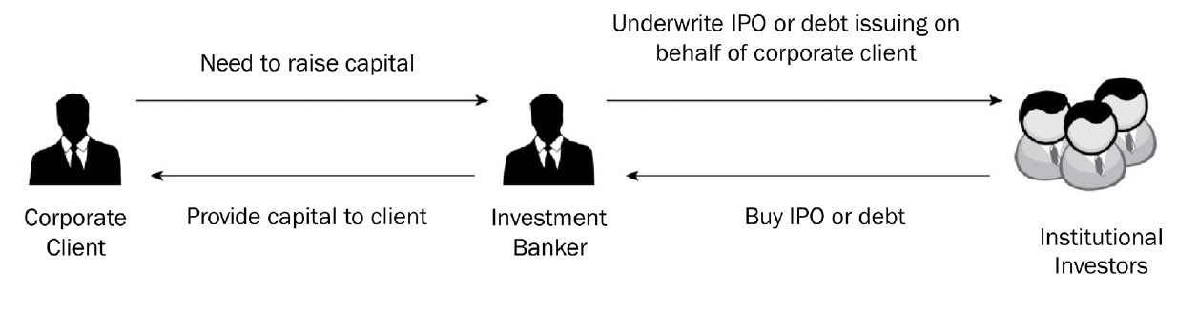
Investment Banking
ML helps automate document searches and analyze structured and unstructured data in investment banking.
This reduces time spent on preparing pitch books, financial models, and extracting relevant information.
The following diagram illustrates the Investment Banking workflow:

Slide 7
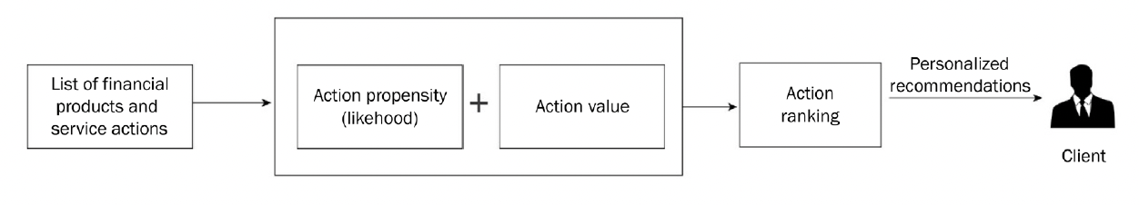
Wealth Management
ML personalizes wealth management solutions by analyzing client data.
Recommendation systems suggest next-best actions for financial advisors to improve client outcomes.
The following diagram illustrates the concept of the Next Best Action method:

Slide 8
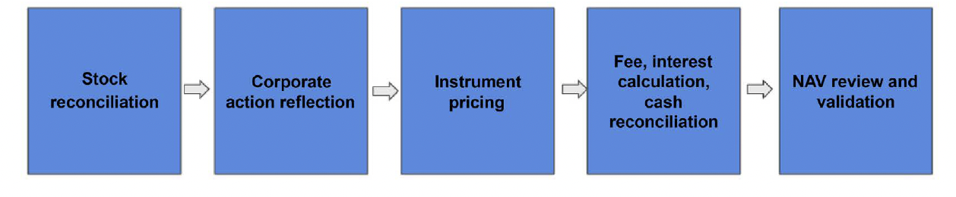
ML in Back Office Operations
Back office operations in financial services use ML for Net Asset Value (NAV) calculations and trade settlement predictions.
ML helps flag pricing exceptions, identify errors, and optimize transaction settlement.
The NAV review process is depicted in the following diagram:

Slide 9
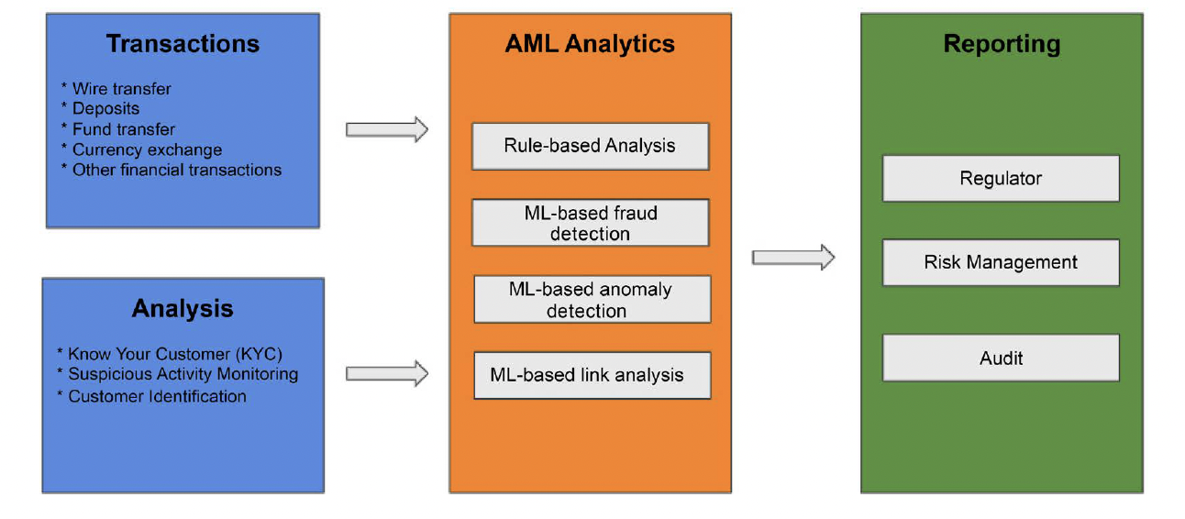
Risk Management & Fraud Detection
ML plays a critical role in anti-money laundering and trade surveillance.
ML detects fraudulent activities, monitors market abuse, and assesses risks in financial transactions.
The following diagram illustrates the Anti-money laundering flow:

Slide 10
ML in Healthcare
In healthcare, ML enhances diagnostic accuracy by analyzing medical images and detecting conditions early.
Predictive analytics powered by ML enables early detection of diseases, leading to improved patient outcomes.
ML accelerates the drug discovery process by analyzing molecular data to identify promising treatments.
Patient care is personalized by analyzing health records, ensuring treatments are tailored to individual needs.
Hospitals use ML to manage resources effectively, optimizing staffing and patient scheduling.

Slide 11
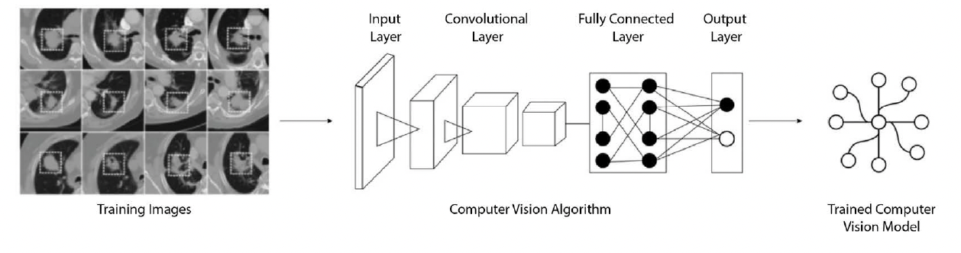
Medical Imaging Analysis
ML models analyze medical images to detect diseases such as cancer, improving diagnostic accuracy.
Computer vision techniques identify anomalies in X-rays, MRIs, and other medical imaging data.
The following diagram illustrates Using computer vision for cancer detection:

Slide 12
Drug Discovery
ML accelerates the drug discovery process by analyzing vast amounts of data from genomics, clinical trials, and molecular biology.
It helps identify potential drug candidates by predicting which molecules will interact effectively with biological targets.
ML models are used to simulate chemical reactions, reducing the time and cost involved in lab experiments.
Predictive analytics help determine the efficacy and safety of drug compounds before human trials.
ML also optimizes clinical trial design, ensuring the right patient cohorts are selected, improving trial success rates.

Slide 13
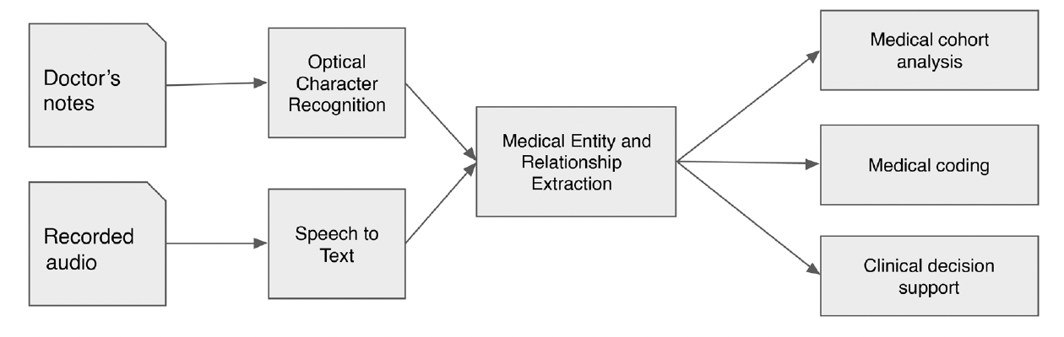
Healthcare Data Management
ML automates the extraction of insights from vast healthcare data, including medical records and imaging.
Natural Language Processing (NLP) processes unstructured medical notes, improving clinical decision-making.
ML enhances data management efficiency, reducing human error and optimizing healthcare workflows.

Slide 14
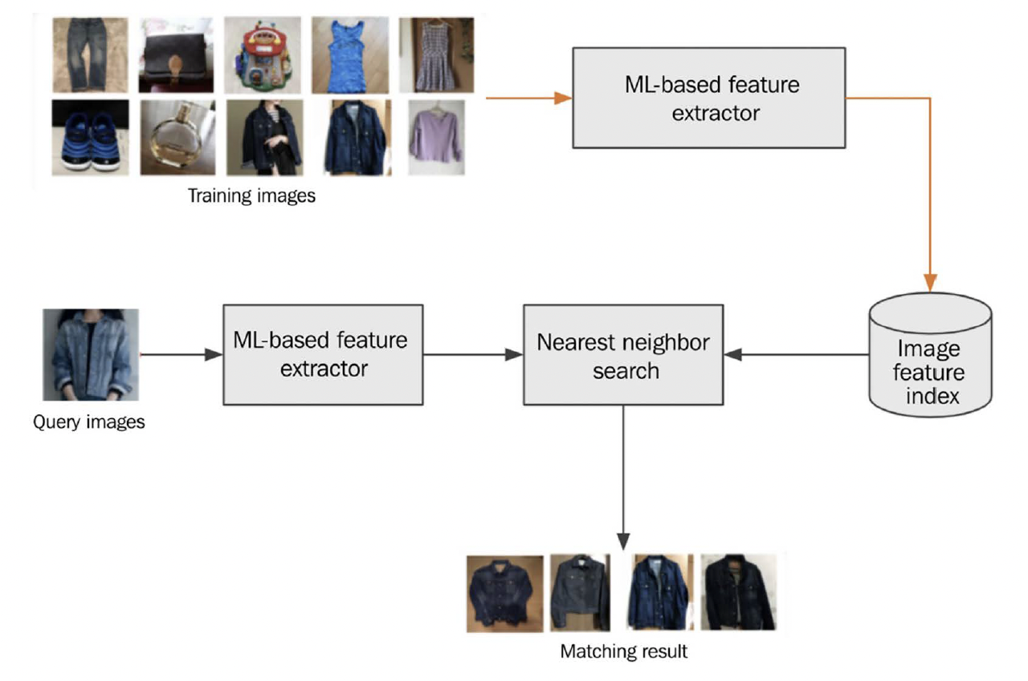
ML in Retail
Retailers use ML to personalize online shopping experiences with recommendation engines and visual search technology.
ML helps retailers better understand customer behavior and predict demand, enhancing inventory management.
The following diagram
illustrates an architecture
for building an ML-based
image search capability:

Slide 15
Targeted Marketing
ML revolutionizes marketing by enabling highly personalized campaigns based on user behavior and preferences.
Customer segmentation with ML allows marketers to target the right audience with tailored offers.
Recommendation engines powered by ML increase customer engagement by suggesting relevant products or services.
ML optimizes digital ad placements, reducing wasted spending and increasing conversion rates.
Marketers use ML to predict customer behavior and refine strategies, resulting in a higher return on investment (ROI).

Slide 16
Sentiment Analysis in Retail
Retailers use ML-driven sentiment analysis to gauge customer opinions from reviews, social media, and feedback.
Analyzing sentiment helps retailers identify areas where products or services can be improved.
Real-time monitoring of brand reputation allows businesses to quickly address negative feedback and respond proactively.
ML models detect emerging trends in customer satisfaction or dissatisfaction, helping businesses stay ahead of issues.
Retailers can use sentiment insights to inform future product development, ensuring alignment with customer needs.

Slide 17
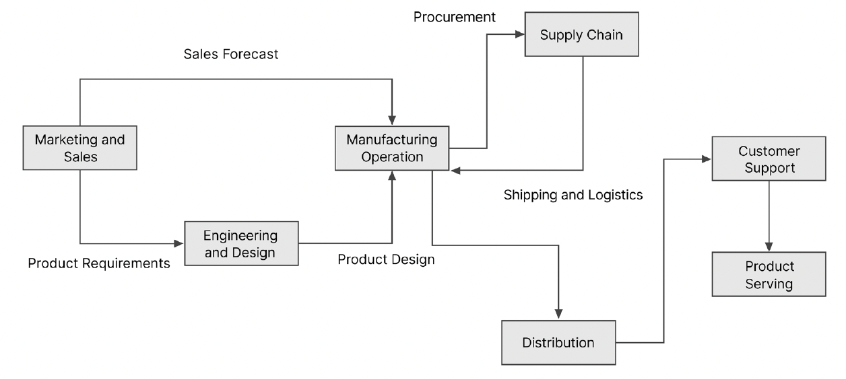
ML in Manufacturing
Manufacturing leverages ML for predictive maintenance, quality control, and supply chain optimization.
ML helps reduce downtime, improve product quality, and enhance operational efficiency.
Manufacturing business process flow:

Slide 18
Predictive Maintenance
Predictive maintenance powered by ML enables industries to forecast equipment failures before they happen.
Sensor data is analyzed in real-time to predict when maintenance is required, reducing unnecessary downtime.
ML helps companies extend the lifespan of equipment by preventing costly and unexpected breakdowns.
Industries like manufacturing, aviation, and automotive rely on predictive maintenance to increase safety and efficiency.
Optimized maintenance schedules through ML reduce operational costs and improve machine reliability.

Slide 19
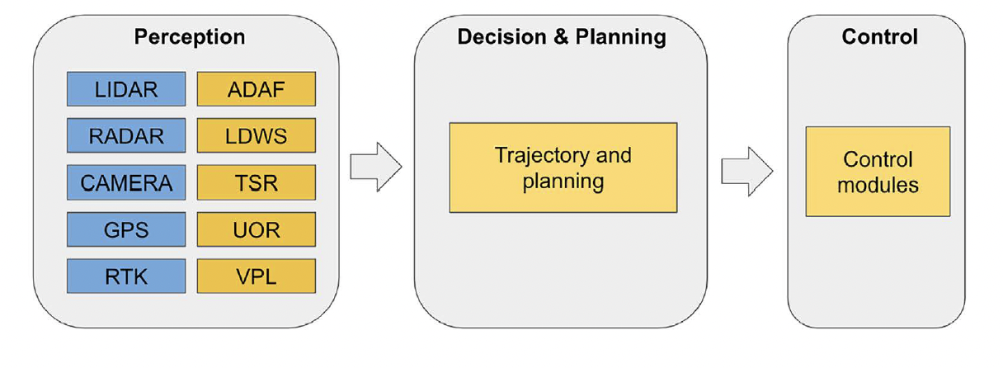
ML in Automotive
Autonomous vehicles (AVs) use AI and ML for decision-making, navigation, and obstacle avoidance.
ML enhances perception, localization, and path planning for AVs.
Autonomous vehicle system architecture:

Slide 20
Advanced Driver Assistance Systems (ADAS)
ADAS leverages ML to enhance vehicle safety by processing data from sensors and cameras in real-time.
Features like adaptive cruise control, lane-keeping assistance, and automatic emergency braking are powered by ML.
ML models continuously learn and improve from driving patterns, making ADAS systems more reliable over time.
ADAS systems reduce human error, assist drivers in critical situations, and prevent potential accidents.
This technology is a stepping stone toward fully autonomous vehicles, which rely heavily on ML for safe operation.

Slide 21
Conclusion
Machine Learning is transforming industries by improving decision-making, operational efficiency, and customer experience.
From healthcare to finance, ML solutions address complex challenges and unlock new opportunities for innovation.
The widespread adoption of ML highlights its potential to reshape business processes and drive future growth.

